Slide 1

Introduction to 8085
Marwadi University
Subject Code:01CE0509
Subject Name: Fundamental of Processors
B.Tech. Year–III
Unit- 1

Slide 2

Outline
Objective of Course
Course Outcomes
Teaching and Examination Scheme
Syllabus
Microprocessor Introduction and Definition
Microcomputer and single chip microcomputer
Microprocessor History
Microprocessor Architecture,
Pin Functions,
Demultiplexing of Buses,
Memory and I/O operation,
Generation of Control Signals,
Basic concepts of Instruction Cycle, Machine Cycles, T-States in 8085
Looping

Slide 3
Objective of Course
Students can learn the necessary knowledge and skills to work with microprocessors.
They can also gain an understanding of the practical applications of microprocessors in various fields.

Slide 4
Course Outcomes
After Completion of this course students will be able to
Understand the architecture of 8085 Microprocessor with other processors.
Understand the architecture and operation of 8086 microprocessors.
Apply the concept of Addressing mode and instruction of 8086 microprocessors.
Write, Debug, & Simulate assemby language programs
Compare the architecture features of advance microprocerssors to design and implement simple microprocessor based systems.

Slide 5
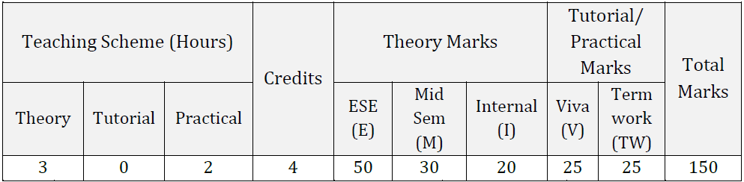
Teaching and Examination Scheme

Slide 6
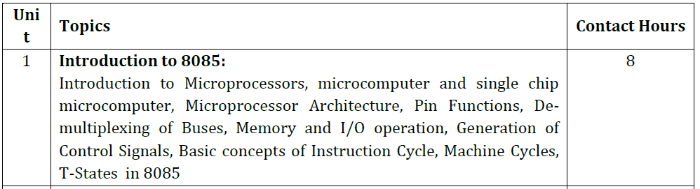
Syllabus: Unit-1 Introduction to 8085

Slide 7
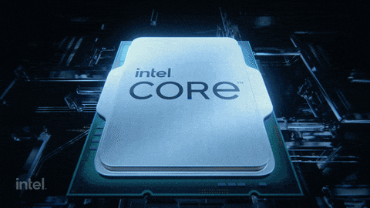
Microprocessor Introduction and Definition
Microprocessor is a
Multipurpose
Programmable
Clock-driven
Register-based electronic device
Reads binary instruction from a storage device (MEMORY)
Accepts binary as input
Processes data according to instruction
Provides Result as output
It is a silicon chip which includes ALU,
register circuits & control circuits

Slide 8
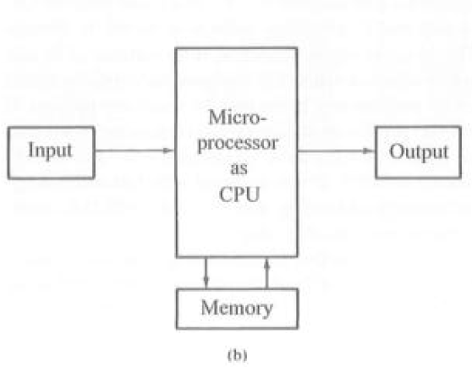
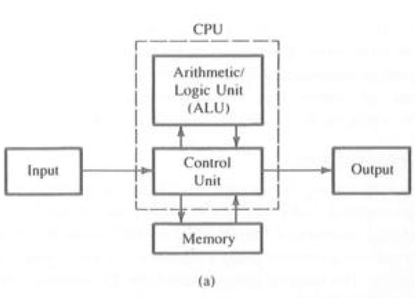
Microcomputer and single chip microcomputer
Computer is made up of four components: (1)Memory (2) input (3)Output (4) CPU
CPU (central processing unit) is consists of Arithmatic/ logic unit (ALU )and Control Unit (CU) as shown in Block Diagram (a).
Earlier ALU and CU are saperate component but later it is possible to make Single chip CPU as shown in Block Diagram (b). Which is known as Microprocessor.
A Computer with a microprocessor as its CPU is known an Microcomputer.

Slide 9
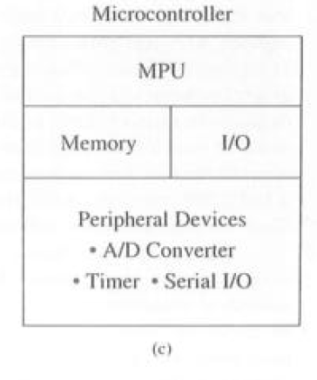
Microcomputer and single chip microcomputer
As Semiconductor Fabrication Technology advanced, It is possible to place Memory and I/O interfacing circuits on a Single chip which is known as Microcontroller.
Microcontroller is a Single chip microcomputer also includes additional devices such as an A/D converter, Serial I/O and Timers as shown in Block diagram (c).

Slide 10

History of Microprocessor
Gordon Moore ,Co founder of Intel, recently passed away.
He is famous for Moore’s Law: “ The number of transistors per integrated circuit would double every 18 months.”

Slide 11
History of Microprocessor
Types of Microprocessor based on data bits:
4-Bit Microprocessors
8-Bit Microprocessors
16-Bit Microprocessors
32-Bit Microprocessors
64-Bit Microprocessors

Slide 12
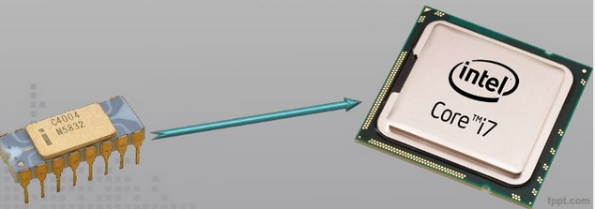
History of Microprocessor
4 bit to 64 bit(4004 to Core i7)

Slide 13
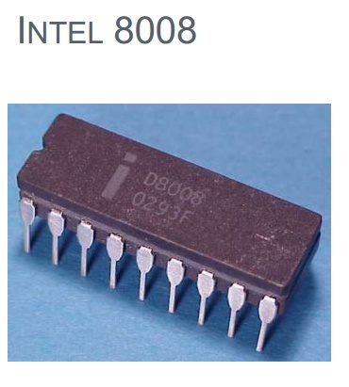
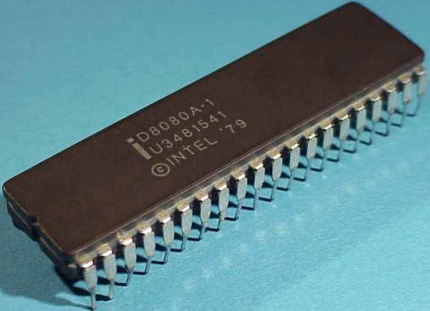
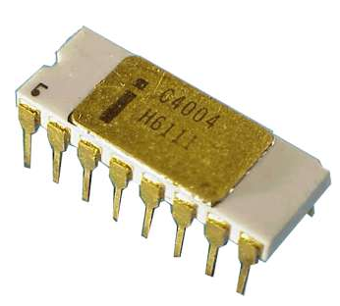
History of Microprocessor
Intel released its first 4-bit microprocessor 4004 in 1971.
4004 quickly replaced by 8-bit Microprocessor the Intel 8008 and later 8008 was updated by 8-bit Microprocessor 8080.
4-Bit Microprocessors
4004
8-Bit Microprocessors
8008 and 8080

Slide 14
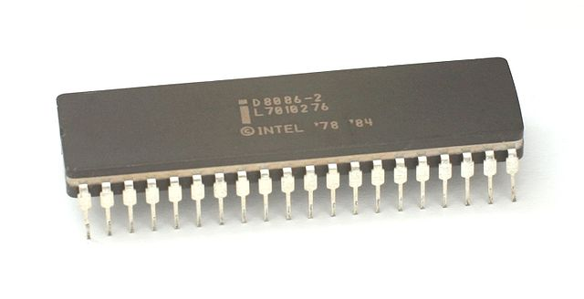
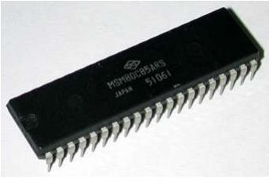
History of Microprocessor
The Intel 8085 Microprocessor were developed as improvements over the 8080.
Most micro computers now built with 32 and 64 bit microprocessor.
To Understand basic concepts of microprocessor, it is easier to understand from simple 8-bit processor than from a 64 bit processor.
This fundamental concepts are easily transferable from 8-bit processor to larger processor.
8-Bit Microprocessors 8085
16-Bit Microprocessors 8086

Slide 15
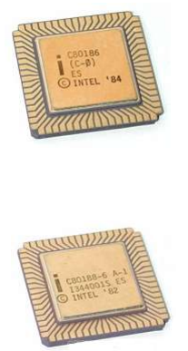
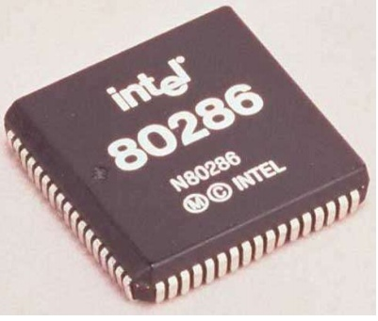
History of Microprocessor
16-Bit Microprocessors
16-Bit Microprocessors

Slide 16
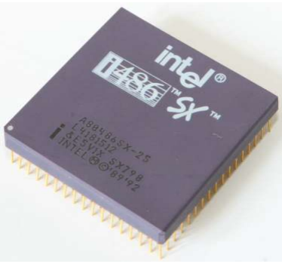
History of Microprocessor
32-Bit Microprocessors

Slide 17
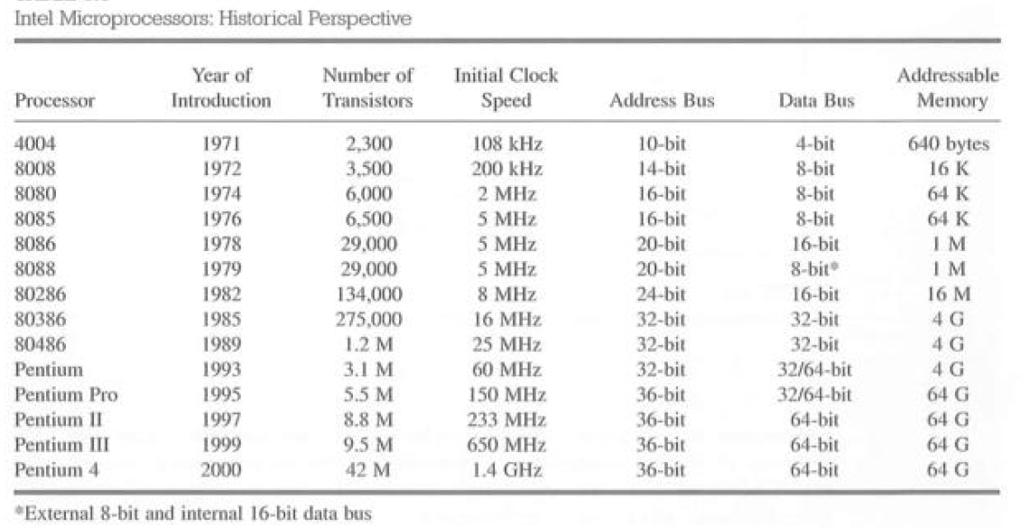
History of Microprocessor

Slide 18
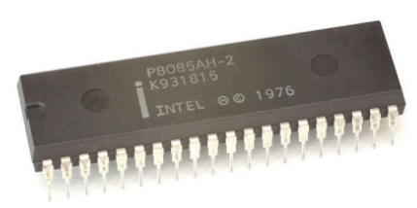
8-bit 8085 Microprocessor
8085 developed in 1976, which has 8 bit data bus and
16 bit address bus.
.

Slide 19
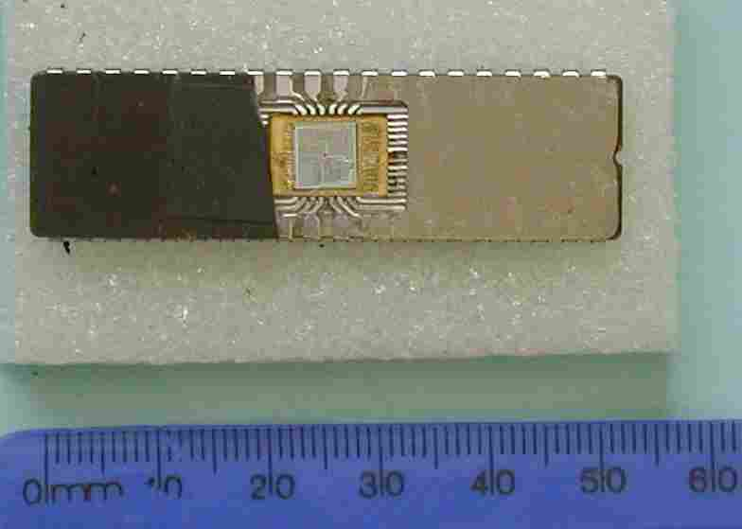
8-bit 8085 Microprocessor
Fig1: 8085 CPU Chip in DIP Package

Slide 20
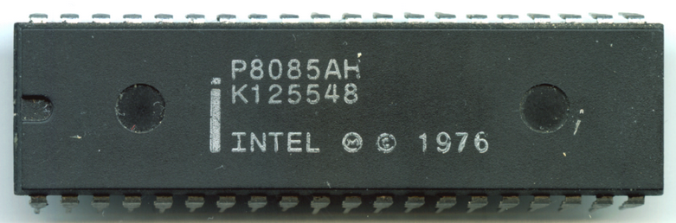
8-bit 8085 Microprocessor
Features of 8085 microprocessor (8-bit)
Single + 5V Supply
40-pin DIP package
It operates at 3.2 MHZ single phase clock with maximum clock frequency 6.144 MHz.
8-bit data bus
16-bit address bus which can address up to 64KB
It provide ACC, One flag register, 6 general purpose registers and two special purpose registers (SP,PC).
It provides 74 instructions with 5 different addressing modes.

Slide 21
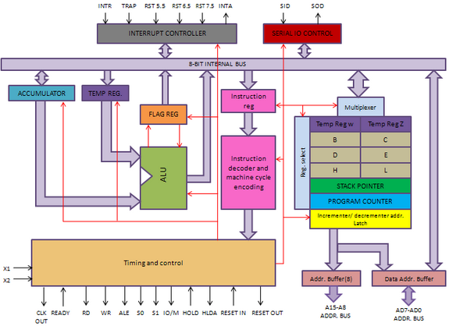
8085 Microprocessor Architecture

Slide 22
8085 Microprocessor Architecture
It consists of 6 essential blocks.
Arithmetic Logic Unit Section
Register Array
The Timing And Control Unit
Instruction Register and Decoder
The Interrupt Control Section
Serial I/O Section

Slide 23
8085 Microprocessor Architecture
1) Arithmetic Logic Unit Section :This section consists of
Accumulator(A)
Temporarily Register (TR)
An Arithmetic Logic Unit (ALU)
Flag Register (FR)
Accumulator(A):
It is 8 bit register and part of ALU.
It is identified by symbol A.
In 8085 operation once data must be in Accumulator.
The result of an operation is stored(accumulated) in the Accumulator.

Slide 24
8085 Microprocessor Architecture
Temporarily Register (TR):
This is an 8 bit register not accessible to the user. It is used by the µp for internal operations.
Arithmetic Logic Unit (ALU):
Perform arithmetical and logical operation.
Flag Register (FR):
The ALU includes five flip-flops, which are set or reset after an operation according to data conditions of the result in the accumulator and other registers.
They are called Sign (S),Zero (Z), Auxiliary Carry (AC), Parity (P), Carry (CY) and flags.

Slide 25
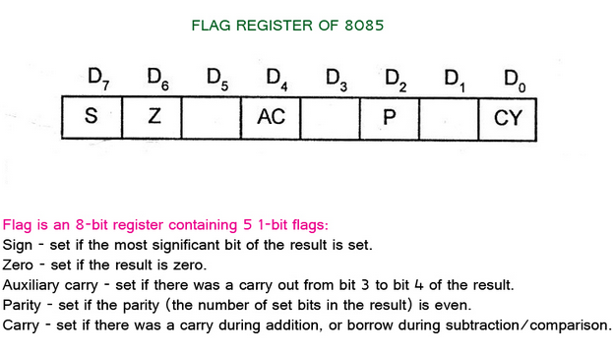
8085 Microprocessor Architecture

Slide 26
8085 Microprocessor Architecture
2) Register Array
6 general purpose 8-bit registers (B, C, D, E, H ,L),
2 temporary registers of 8 bit (W and Z)
Two 16-bit registers:
The Program Counter (PC),
The Stack Pointer (SP)
Address buffer and address/data bus buffer
The 8085 has six general-purpose registers to store 8-bit data;
B, C, D, E, H, and L.
They can be combined as register pairs - BC, DE, and HL - to perform some 16-bit operations.
The programmer can use these registers to store or copy data into the registers by using data copy instructions.

Slide 27
8085 Microprocessor Architecture
2) Register Array
W and Z : Used only for internal operation purpose . Not available for user to program it.
These are two 16-bit registers used to hold memory addresses.
1) PC(Program Counter): Sequencing the execution of the program
The function of the PC is to point(hold) to the memory address from which the next byte is to be fetched.
When a byte (machine code) is being fetched, the program counter is incremented by one to point to the next memory location.
2) SP: Stack Pointer
It points to a memory location in R/W memory, called the stack.
The beginning of the stack is defined by loading a 16-bit address in the stack pointer.

Slide 28
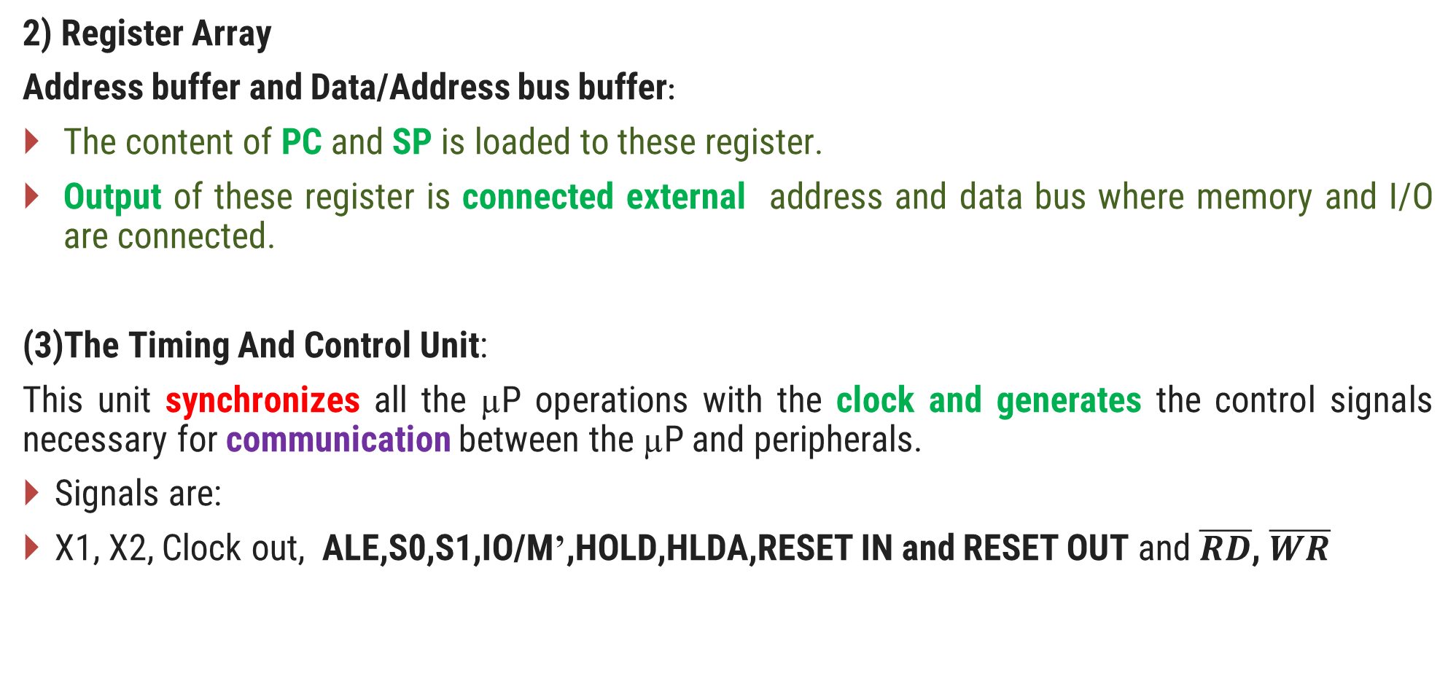
8085 Microprocessor Architecture
2) Register Array
Address buffer and Data/Address bus buffer:
The content of PC and SP is loaded to these register.
Output of these register is connected external address and data bus where memory and I/O are connected.
(3)The Timing And Control Unit:
This unit synchronizes all the µP operations with the clock and generates the control signals necessary for communication between the µP and peripherals.
Signals are:
X1, X2, Clock out, ALE,S0,S1,IO/M’,HOLD,HLDA,RESET IN and RESET OUT and $\overline{RD}$, $\overline{WR}$

Slide 29
8085 Microprocessor Architecture
(4) Instruction Register and Decoder:
When instruction is fetched from memory ,it is loaded in the IR.
The decoder decodes the instruction and establishes the sequence of events to follow.
The IR is not programmable.
(5) The Interrupt Control Section
It handles interrupt of 8085
5 interrupt inputs .
TRAP 2) RST7.5 3) RST6.5 4) RST5.5 5) INTR
INTA (INTerrupt Acknowledgement)
(6) Serial I/O Section
Two Lines- SOD and SID – used for serial communication

Slide 30
8085 PIN DIAGRAM

Slide 31
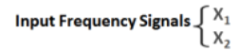
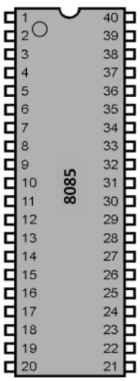


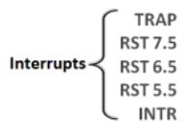
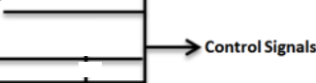
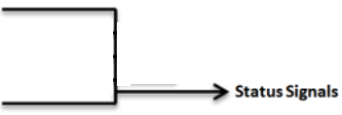
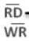
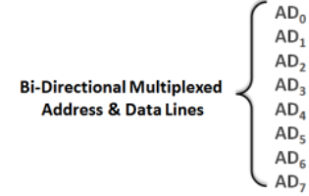
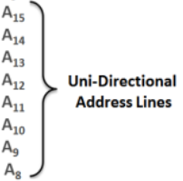

Slide 32
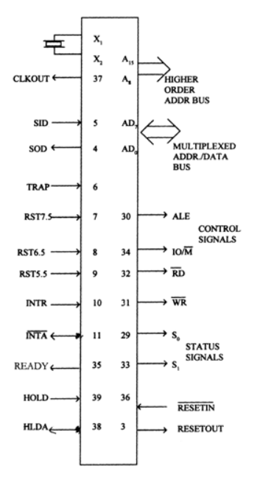
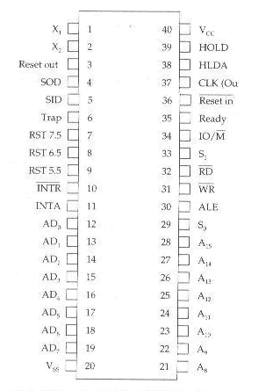
8085 PIN DIAGRAM

Slide 33
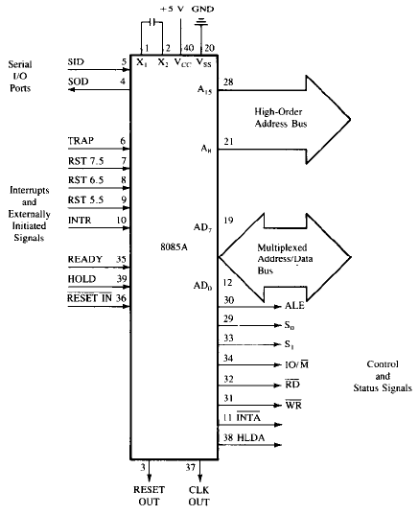
8085 Signals

Slide 34
8085 Microprocessor Pin Functions
8085 is a 40 pin IC, The signals from the pins can be grouped as follows
Power supply and clock frequency signals(4)
Address bus(8+8)
Data bus(8)
Control and status signals(6)
Interrupts and Externally initiated signals(12)
Serial I/O (2)

Slide 35
8085 Microprocessor Pin Functions
Power supply and clock frequency signals
Vcc: + 5 volt power supply – Input pin
Vss: Ground
X1,X2
Crystal or R/C network or LC network connections to set the frequency of internal clock generator.
The frequency is internally divided by two.
Since the basic operating timing frequency is 3 MHz, a 6 MHz crystal is connected externally.
Input pin
CLK -Clock Output is used as the system clock for peripheral and devices interfaced with the microprocessor. –output pin

Slide 36
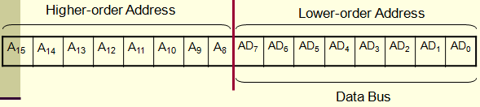
8085 Microprocessor Pin Functions
Address Bus:
A8-A15
This is output pins
The 8085 has eight signal lines ,A8 to A15 which are unidirectional and used as the high order address bus.

Slide 37
8085 Microprocessor Pin Functions
Multiplexed Address /Data Bus:
AD0 - AD7 (input/output)
These multiplexed(Combined) set of lines used to carry the lower order 8 bit address as well as 8 bit data.
During the op-code fetch operation, in the beginning clock cycle, the lines deliver the lower order address A0 - A7 and later part of the cycle these lines are used as the data bus Do – D7.
This bus is bidirectional.

Slide 38
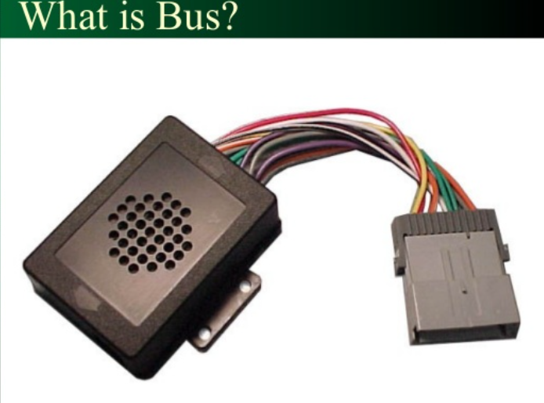
System Bus(Data,Address and Control bus)
Bus

Slide 39
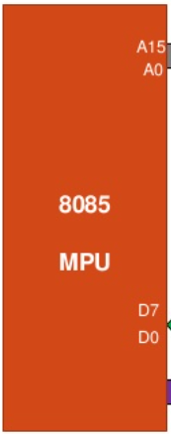


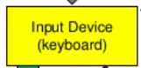
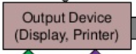




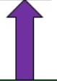


8085 Bus structure

Slide 40
System Bus(Data , Address and control bus)
The system bus is a group of wires/Copper tracks used to carry information between a computer microprocessor and the main memory and I/O.
Each wire can carry one bit.
i.e. if total 8 bits needed to be carried then 8 wires are required.
Name of bus is given according to their function.
1) Data bus :
2) Address bus
3) Control Bus

Slide 41
System Bus(Data , Address and control bus)
1) Data bus :
carries data and information between components.
Bidirectional.
More number of bits can be carried at the same time
if more width of Data bus.
2) Address bus :
carries address from processor to memory and I/O .
Unidirectional.
Address bits indicates memory support capacity of any
processor. i.e. If 3 wires for address ,so total 8 (2^3)
Location of memory can be address .
3) Control bus :
carries timing and control signal from processor.
unidirectional.

Slide 42
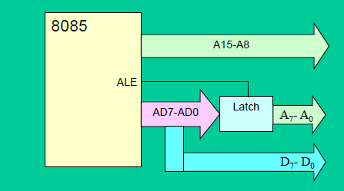
8085 pin diagram

Slide 43

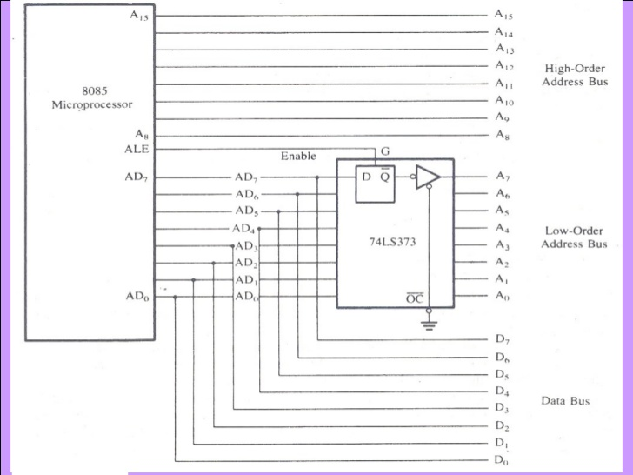
DEMULTIPLEXING OF ADDRESS BUS & DATA BUS

Slide 44
Need for Demultiplexing…
A₁₅ – A₈
8085
Memory
20H
AD₇ – AD₀
05H
4FH
2005H

Slide 45
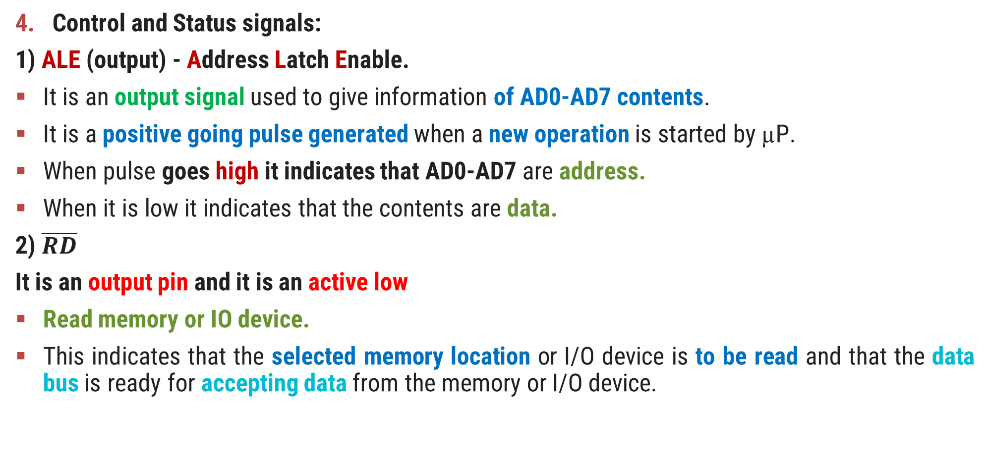
8085 Microprocessor Pin Functions
Control and Status signals:
1) ALE (output) - Address Latch Enable.
It is an output signal used to give information of AD0-AD7 contents.
It is a positive going pulse generated when a new operation is started by µP.
When pulse goes high it indicates that AD0-AD7 are address.
When it is low it indicates that the contents are data.
2) $\overline{RD}$
It is an output pin and it is an active low
Read memory or IO device.
This indicates that the selected memory location or I/O device is to be read and that the data bus is ready for accepting data from the memory or I/O device.

Slide 46
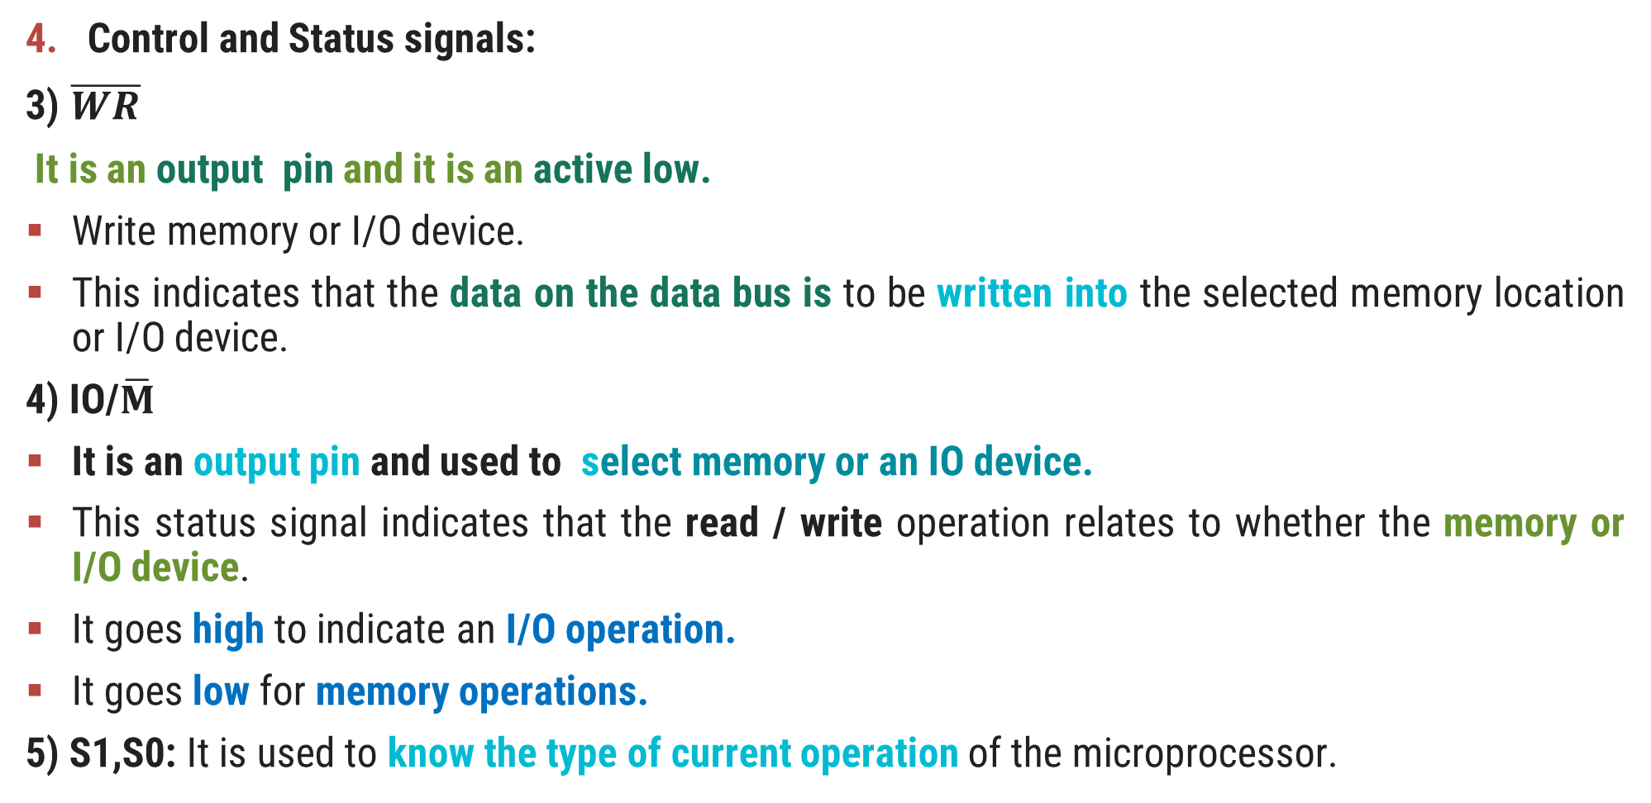
8085 Microprocessor Pin Functions
Control and Status signals:
3)$\overline{WR}$
It is an output pin and it is an active low.
Write memory or I/O device.
This indicates that the data on the data bus is to be written into the selected memory location or I/O device.
4) IO/$\overline{M}$
It is an output pin and used to select memory or an IO device.
This status signal indicates that the read / write operation relates to whether the memory or I/O device.
It goes high to indicate an I/O operation.
It goes low for memory operations.
5)S1,S0: It is used to know the type of current operation of the microprocessor.

Slide 47
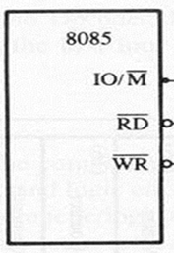
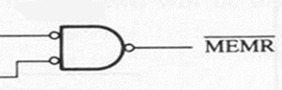
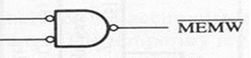
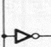
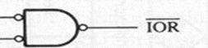
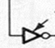
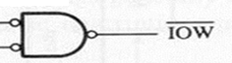
7404

Slide 48




Case 1 I/M = 0 ,RD = 0 and WR = 1
Memory Read signal
Case 1 I/M = 0 ,RD = 1 and WR = 0
Memory Write signal
Case 1 I/M = 1 ,RD = 0 and WR = 1 I/O Read signal
Case 1 I/M = 1 ,RD = 1 and WR = 0 I/O Write signal

Slide 49

8085 Microprocessor Pin Functions
8085 Machine Cycle Status and Control Signals.

Slide 50

8085 Microprocessor Pin Functions
Interrupts and Externally initiated operations:
They are the signals initiated by an external device to request the microprocessor to do a particular task or work.
There are five hardware interrupts called,
On receipt of an interrupt, the microprocessor acknowledges the interrupt by the active low INTA (Interrupt Acknowledge) signal.

Slide 51

8085 Microprocessor Pin Functions
Interrupts and Externally initiated operations:
Responding→“delayedor immediate”
“Maskable or Non-maskable ”Trap is non maskable.
Vectored: The address of the subroutine is already known to the Microprocessor.(Trap , RST 7.5,RST 6.5 and RST 5.5 ).
Non Vectored: The device will have to supply the address of the subroutine to the Microprocessor.(INTR).

Slide 52

8085 Microprocessor Pin Functions
Interrupts and Externally initiated operations:

Slide 53
8085 Microprocessor Pin Functions
Interrupts and Externally initiated operations:
Reset In ( active low)
This signal is used to reset the microprocessor.
Input signal
The program counter inside the microprocessor is set to zero.
Reset Out (Output):
It indicates CPU is being reset.
Output signal
Used to reset all the connected devices when the microprocessor is reset.
Serial I/O: The 8085 has 2 signals to implement the serial transmission those are
SID – Serial Input Data
SOD – Serial Output Data

Slide 54
1. T-STATE
2. MACHINE CYCLE
3. INSTRUCTION CYCLE
4. DIFFERENT MACHINE TIMING DIAGRAM
5. EXAMPLES OF INSTRUCTION CYCLES

Slide 55
T- State
Microprocessor performs an operation in a specific time period i.e. specific clock cycles.
Each clock cycle is called as T-state.
T - STATE

Slide 56

Machine Cycle:
The time required to access the memory or input/output devices is called machine cycle
Machine cycle consists of 3 to 6 T-states.

Slide 57
Machine Cycle:
Question: Name different types of machine cycles executed by the 8085 microprocessor?(GTU exam que.)
There are total seven machine cycles in 8085 MP,
Opcode Fetch (4T to 6 T-state)
Memory Read (3 State)
Memory Write (3 State)
I/O Read (3 State)
I/O Write (3 State)
INTR Acknowledge
Bus Idle

Slide 58

Instruction Cycle
It is defined as the time required to complete the execution of an instruction called Instruction Cycle.
1 Instruction cycle consists of 1 to 6 machine cycle.

Slide 59
Status Signals
STATUS SIGNALS
MACHINE CYCLE | IO/M | S₁ | S₀
OPCODE FETCH | 0 | 1 | 1
MEMORY READ | 0 | 1 | 0
MEMORY WRITE | 0 | 0 | 1
I/O READ | 1 | 1 | 0
I/O WRITE | 1 | 0 | 1
INTERRUPT ACKNOWLEGE | 1 | 1 | 1
BUS IDEAL | 0 | 0 | 0

Slide 60
Timing diagram
Timing Diagram is a graphical representation.
It represents the execution time taken by each instruction in a graphical format.
The execution time is represented in T-states.
Representation of instruction cycle,machine cycle and T state.

Slide 61
1. OPCODE FETCH OPERATION
The first operation in any instruction is opcode fetch.
The microprocessor needs to get(fetch) this machine code from memory where it is stored before the microprocessor can begin to execute the instruction.
It contains 4 to 6 T-states.
In Opcode Fetch - first three states T₁ – T₃ used to fetch code and fourth state T₄ used to decode and execute opcode.

Slide 62



Rules for timing diagram

Slide 63
T₁
T₂
T₃
T₄
MACHINE CYCLE (OPCODE FETCH)
CLK
0000H LDA CO50H
A₁₅ – A₈
00H
HIGH-ORDER MEMROY ADDRESS
UNSPECIFIED
AD₇ – AD₀
00H
3AH
OPCODE
LOW-ORDER
MEMROY ADDRESS
ALE
IO/M S_{1 ,} S₀
STATUS IO/M = 0, S₁ = 1, S₀ = 1 OPCODE FETCH
RD

Slide 64

Timing Diagram of byte transfer from memory to MPU

Slide 65
Timing Diagram of byte transfer from memory to MPU
The Opcode Fetch Execute Sequence :
The μp places a 16 bit memory address from PC (program counter) to address bus.
Figure : at T1
The high order address, 20H, is placed at A15 – A8.
the low order address, 05H, is placed at AD7 - AD0 and ALE is active high.
Synchronously the IO/M’ is in active low condition to show it is a memory operation.

Slide 66
Timing Diagram of byte transfer from memory to MPU
The Opcode Fetch Execute Sequence :
At T2 the active low control signal, RD, is activated so as to activate read operation; it is to indicate that the MPU is in fetch mode operation.
T3: The active low RD signal enabled the byte instruction, 4FH, to be placed on AD7 – AD0 and transferred to the MPU. While RD high, the data bus will be in high impedance mode.
T4: The machine code, 4FH, will then be decoded in instruction decoder. The content of accumulator (A) will then copied into C register at time state, T4.

Slide 67
2) Timing Diagram of Memory Read Machine Cycle of 8085:
The memory read machine cycle is executed by the processor to read a data byte from memory.
The processor takes 3T states to execute this cycle.

Slide 68

2) Timing Diagram of Memory Read Machine Cycle of 8085:
00
01
50H

Slide 69
3) Timing Diagram of Memory Write Machine Cycle of 8085:
The memory write machine cycle is executed by the processor to write a data byte in a memory location.
The processor takes, 3T states for this machine cycle.

Slide 70

3) Timing Diagram of Memory Write Machine Cycle of 8085:

Slide 71
Thank You

